Slide 1
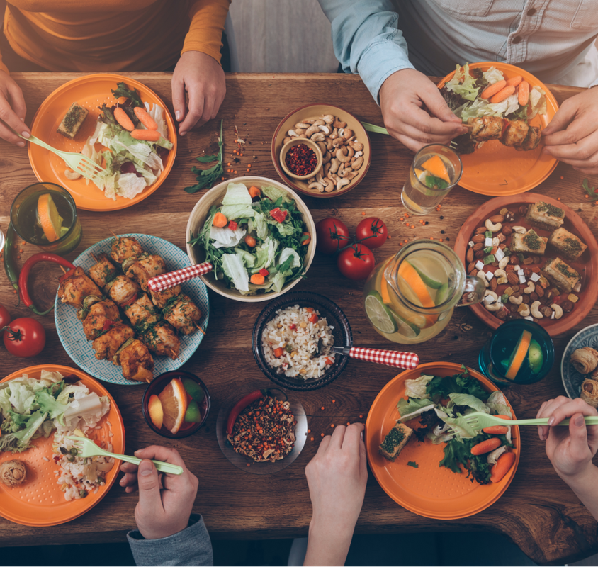
FOOD ORDERING
Group 11
ONLINE
SYSTEM
Guided By:-
Submitted By:-
Dr. G Prabu Kanna
Shital Gupta 22MCA10022
Aastha Kumari 22MCA10098
Shrey Srivastava 22MCA10154
Priyanshu Saraswat 22MCA10155
Farheen Kouser 22MCA10198

Slide 2
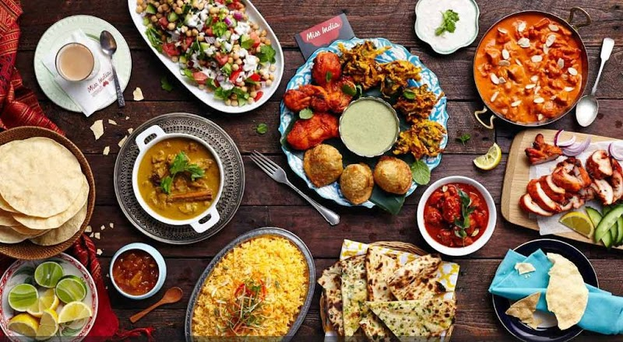
Contents
Introduction
Proposed work and Methodology
System Requirement
Architecture and Flow Diagram
Module Explanation
Results
Conclusion

Slide 3
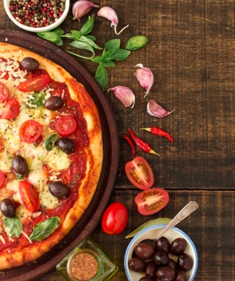
Introduction
The Online Food Ordering System is to automate the existing manual system by the help of computerized equipment’s and full-fledged computer software, fulfilling their requirements, so that their valuable data/information can be stored for a longer period with easy accessing and manipulation of the same. The required software and hardware are easily available and easy to work with.

Slide 4
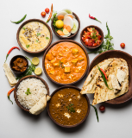
Proposed work and Methodology
Order Food online system is a process in which one can order various foods and beverages from some local restaurant and hotels using the internet, just by sitting at home or any place and giving user an amazing experience ordering online . And the order is delivered to the old location. The user can place orders for the food items of their like from the list. The payment can be made online or pay-on-delivery system. The user’s details are maintained confidentially because it maintains a separate account for each user. An id and password are provided for each user.

Slide 5
SYSTEM REQUIREMENT
SOFTWARE REQUIREMENT
Name of Component | Specification
Operating System | Windows 8.1/10 , MAC
Language | React
Database | MongoDb
Browser | Any of Chrome, Mozilla, Opera etc.
Framework | MERN Stack
Web Technologies | ReactJs, NodeJs, ExpressJs

Slide 6
SYSTEM REQUIREMENT
HARDWARE REQUIREMENT
Minimum RAM | 4GB
Processor | Core i3
Free Space | 1 GB

Slide 7
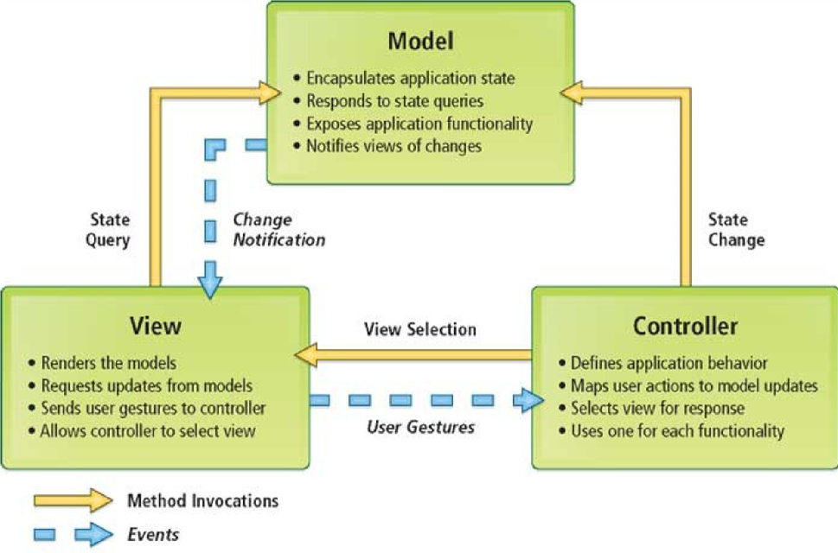
Architecture and Flow Diagram
Model View Controller or MVC as it is popularly called, is a software design pattern for developing web applications. A Model View Controller pattern is made up of the following three parts:
Model - The lowest level of the pattern which is responsible for maintaining data.
View - This is responsible for displaying all or a portion of the data to the user.
Controller - Software Code that controls the interactions between the Model and View.

Slide 8
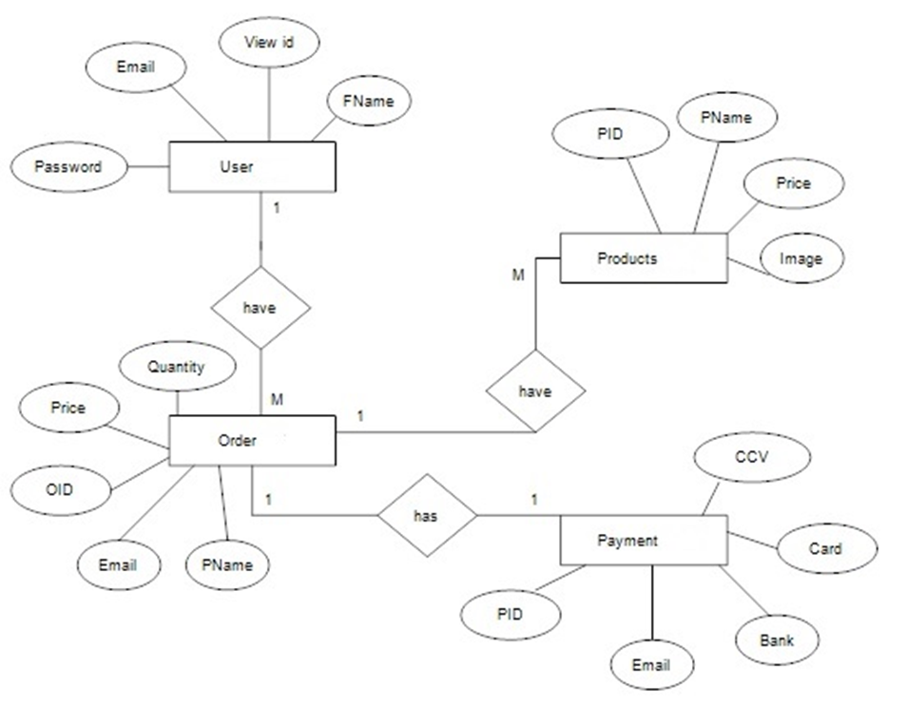
ER DIAGRAM

Slide 9
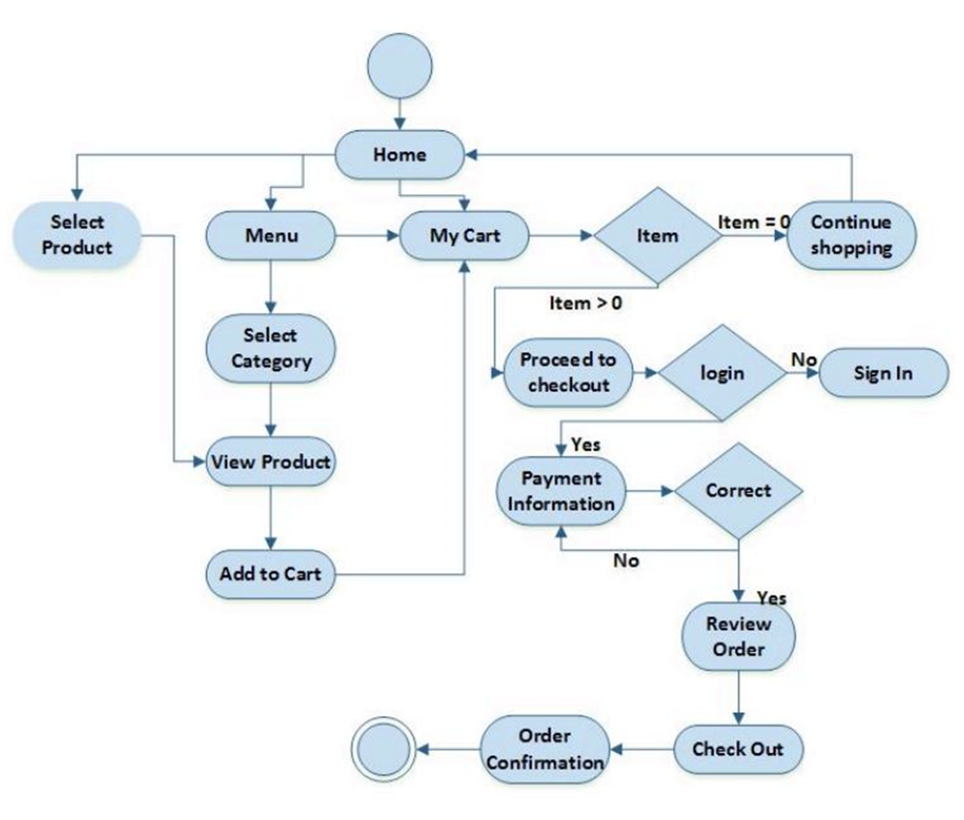
DFD

Slide 10
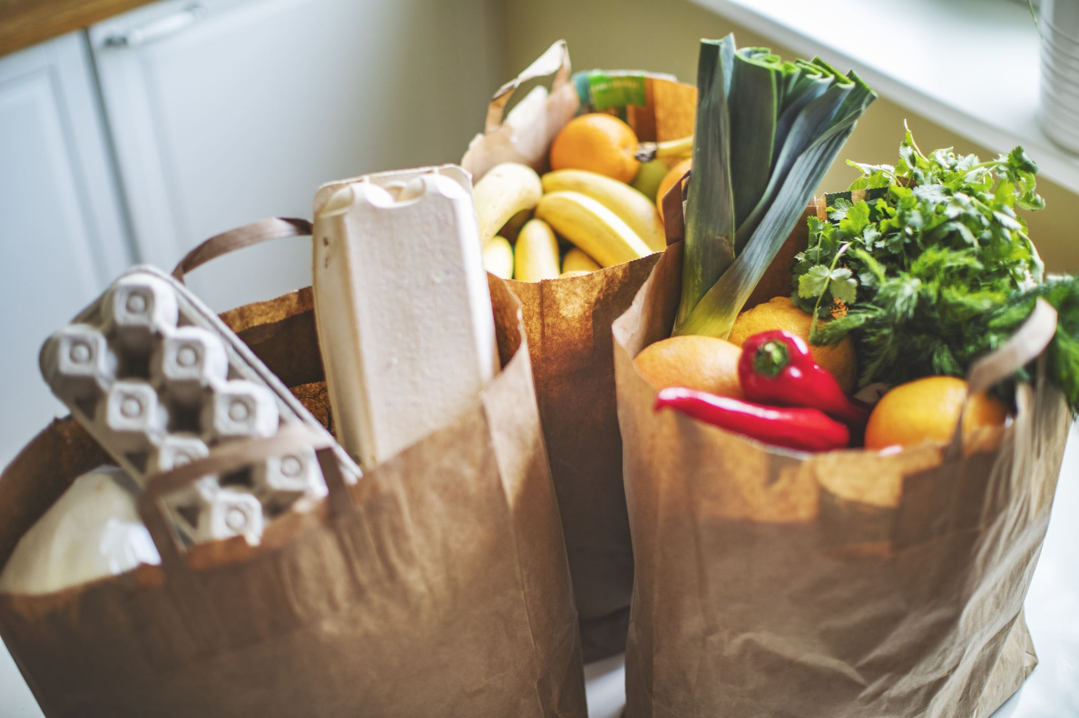
MODULE EXPLANATION
The online food ordering system provides convenience for the customers that are nothing special but the general busy people of the society. It overcomes the demerits of the manual hotel or mess system and the old-fashioned queuing system. This system enhances the ready-made foods that people.
In the present scenario, people must physically visit the hotels or restaurants for eating food and must make payments through cash mode most of the time due to unawareness of advanced technologies at certain places. In this method time as well as physical work is required, among which time is something that no one has in ample amount

Slide 11
DESCRIPTION
This online application enables the end-users to register to the system online, select the food items of their choice from the menu list, and order food online. Also, the payment can be made through online mode or at the time of home delivery depending upon the customer’s choice and convenience.
The aim of proposed system is to develop a system of improved facilities. The proposed system can overcome all the limitations of the existing system.

Slide 12
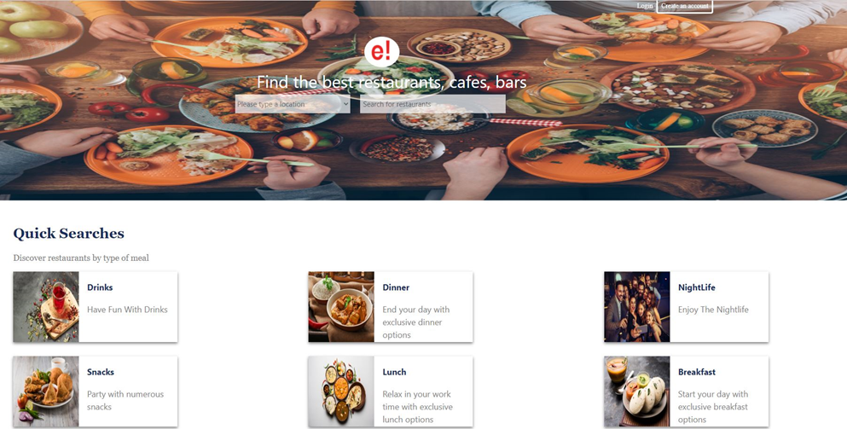
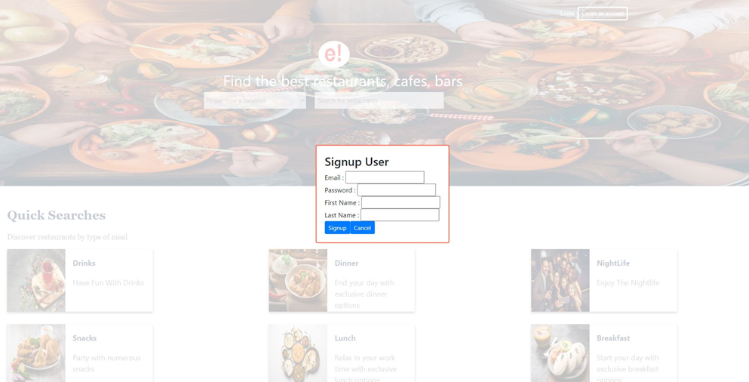
RESULT

Slide 13
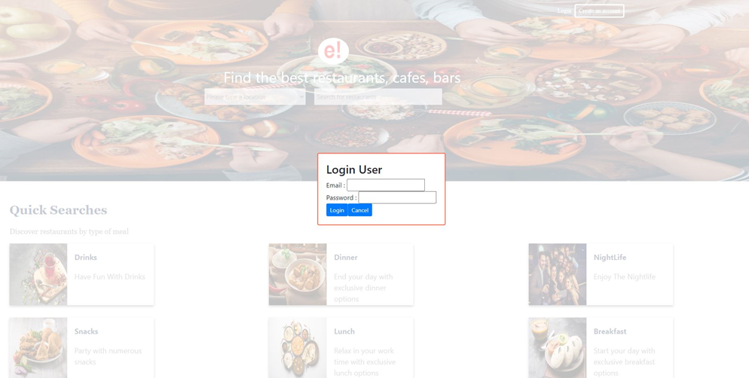
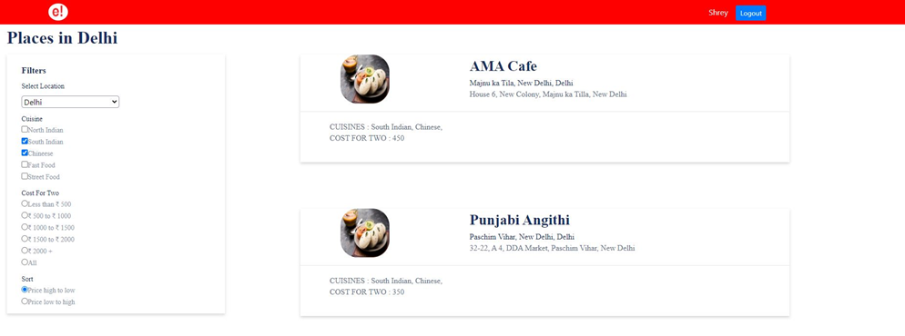
RESULT

Slide 14
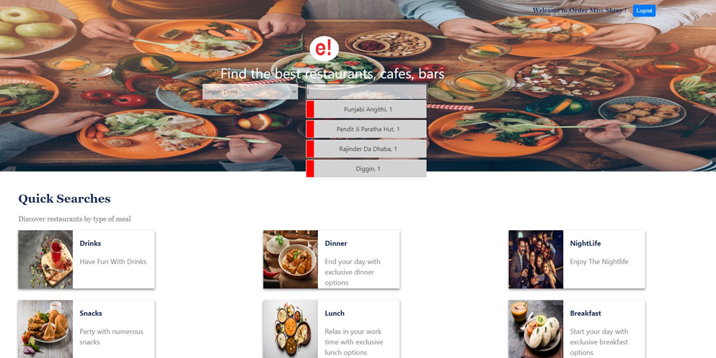
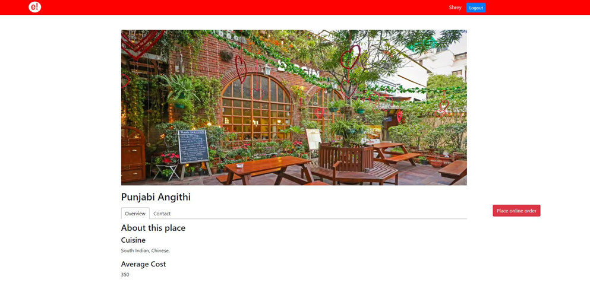
RESULT

Slide 15
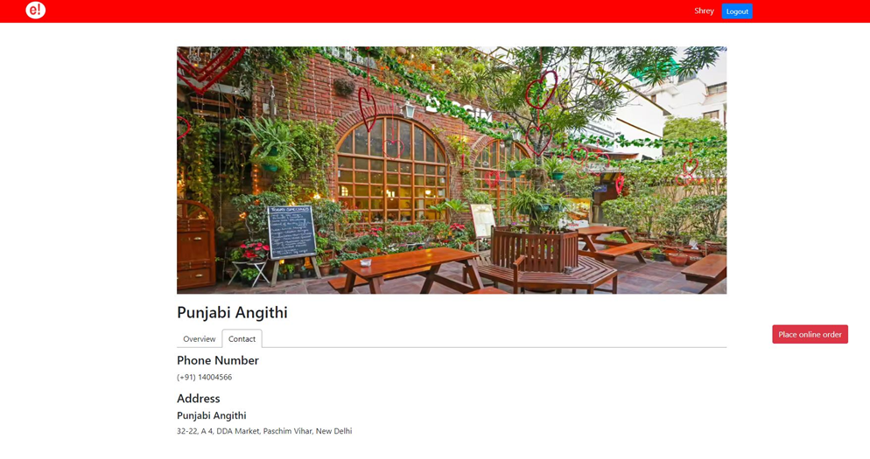
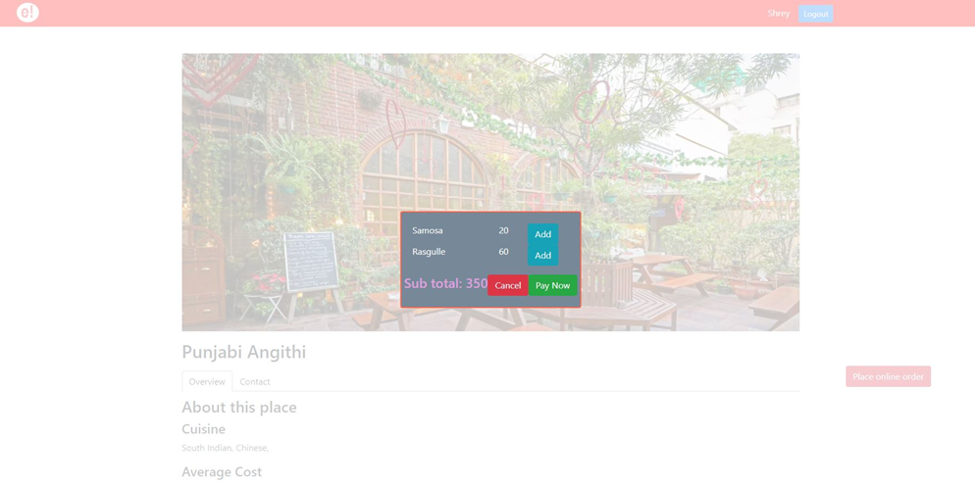
RESULT

Slide 16
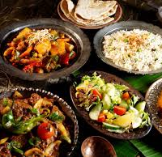
CONCLUSION
The objective of software planning is to provide a framework that enables the manger to make reasonable estimates made within a limited time frame at the beginning of the software project and should be updated regularly as the project progresses.
This online application enables the end-users to register to the system online, select the food items of their choice from the menu list, and order food online. Also, the payment can be made through online mode or at the time of home delivery depending upon the customer’s choice and convenience.

Slide 17
THANK YOU

